Slide 1

IRON
HACK
Web Scraping
Project
By: Christopher Angeles

Slide 2

Micromania Market Strategy
Christopher Angeles

Slide 3
Micromania
Micromania is looking to acquire large amount of inventory
Acquisition of preowned games
Selling New always greater profit than preowned
Goal: Optimize market strategy for what types of preowned games makes most profit

Slide 4
A STRATEGY TIMELINE
Research
Data Acquisition
Research and find best website to scrape data for analysis
Using Intermediate Python and Pandas library to acquire data from a website and store in MySQL database
Research
Data Acquisition
Wrangling
Analysis
Report
Modify and Clean data so it can be utilized and analyzed later
Report data in a clear, informed method to client
Perform analysis on the database acquired to give insight into what strategy will yield largest profit margin via MySQL
Wrangling
Analysis
Report

Slide 5
DATA ACQUISITION IS KEY…
GENRE
Find the most popular genres in video game sales
CONSOLE
Which console related to the most popular games being sold
NEW vs. PREOWNED PRICE
Largest profits between selling pre owned vs selling new in relation to genre and console

Slide 6
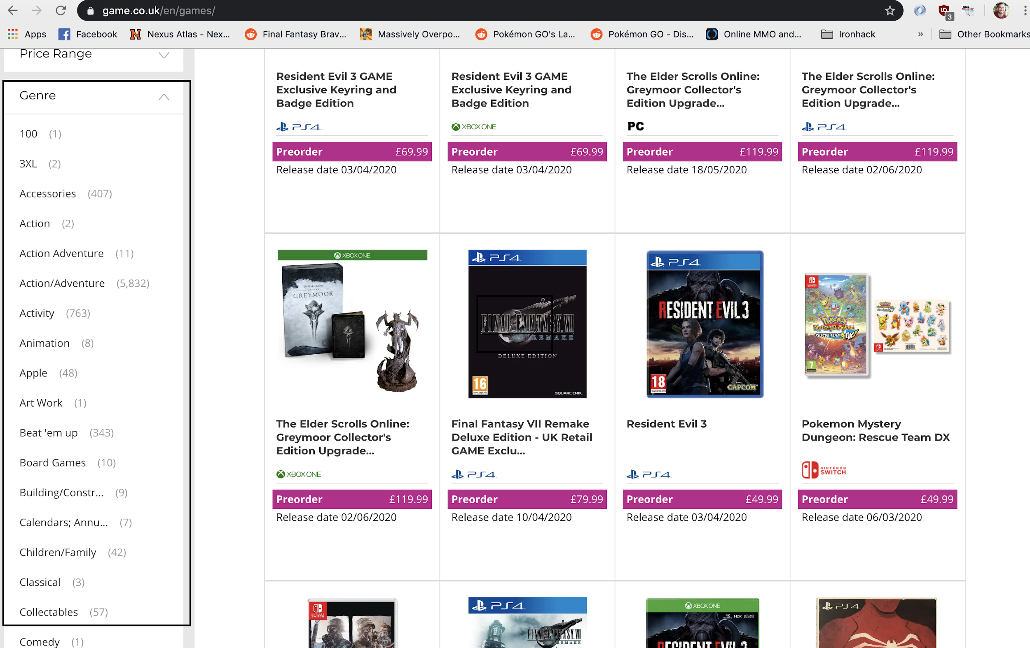
Scraping Data Links

Slide 7

Scraping Data Links
Created a database with just the links for each website directory

Slide 8
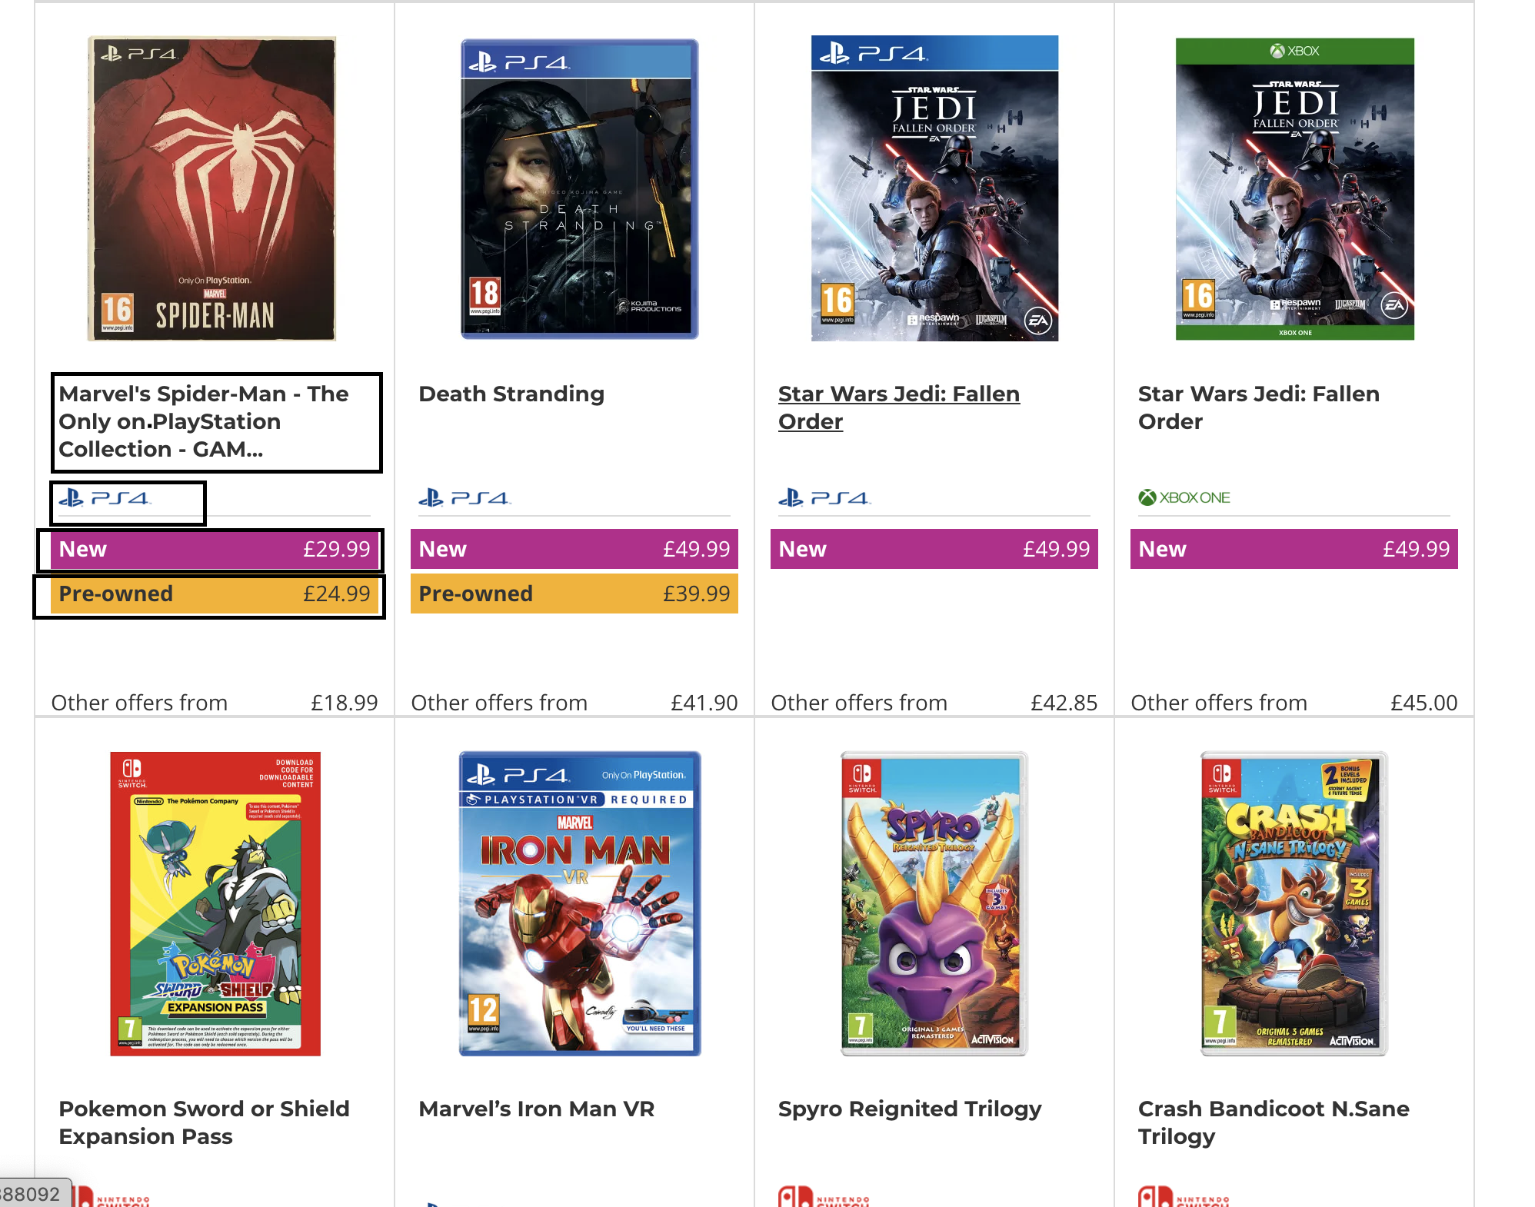
Scraping All Games per Genre
Created second database with name, console, and prices

Slide 9
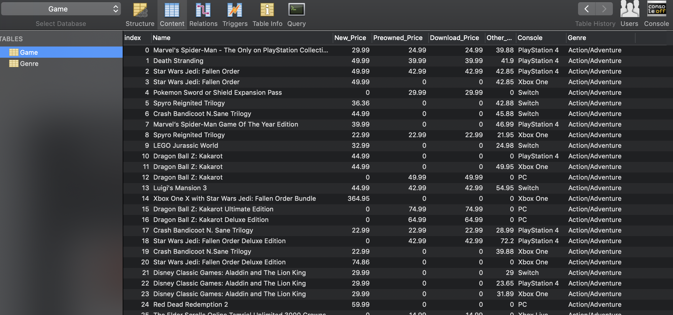
Database in MySQL

Slide 10
ARE PROFITS FROM PREOWNED GAME SALES DECLINING?
IN-GAME DIGITAL SALES
DOWNLOADS
Majority of profits in download sales due to the price ceiling being nearly nonexistent
Despite the fear of ownership, more buyers prefer digital media
PREOWNED SALE
NEW SALE
The physical based media market is split between new and preowned sales
A large percent of the market is dominated by new, physical based media
* Percentages are not actually true

Slide 11
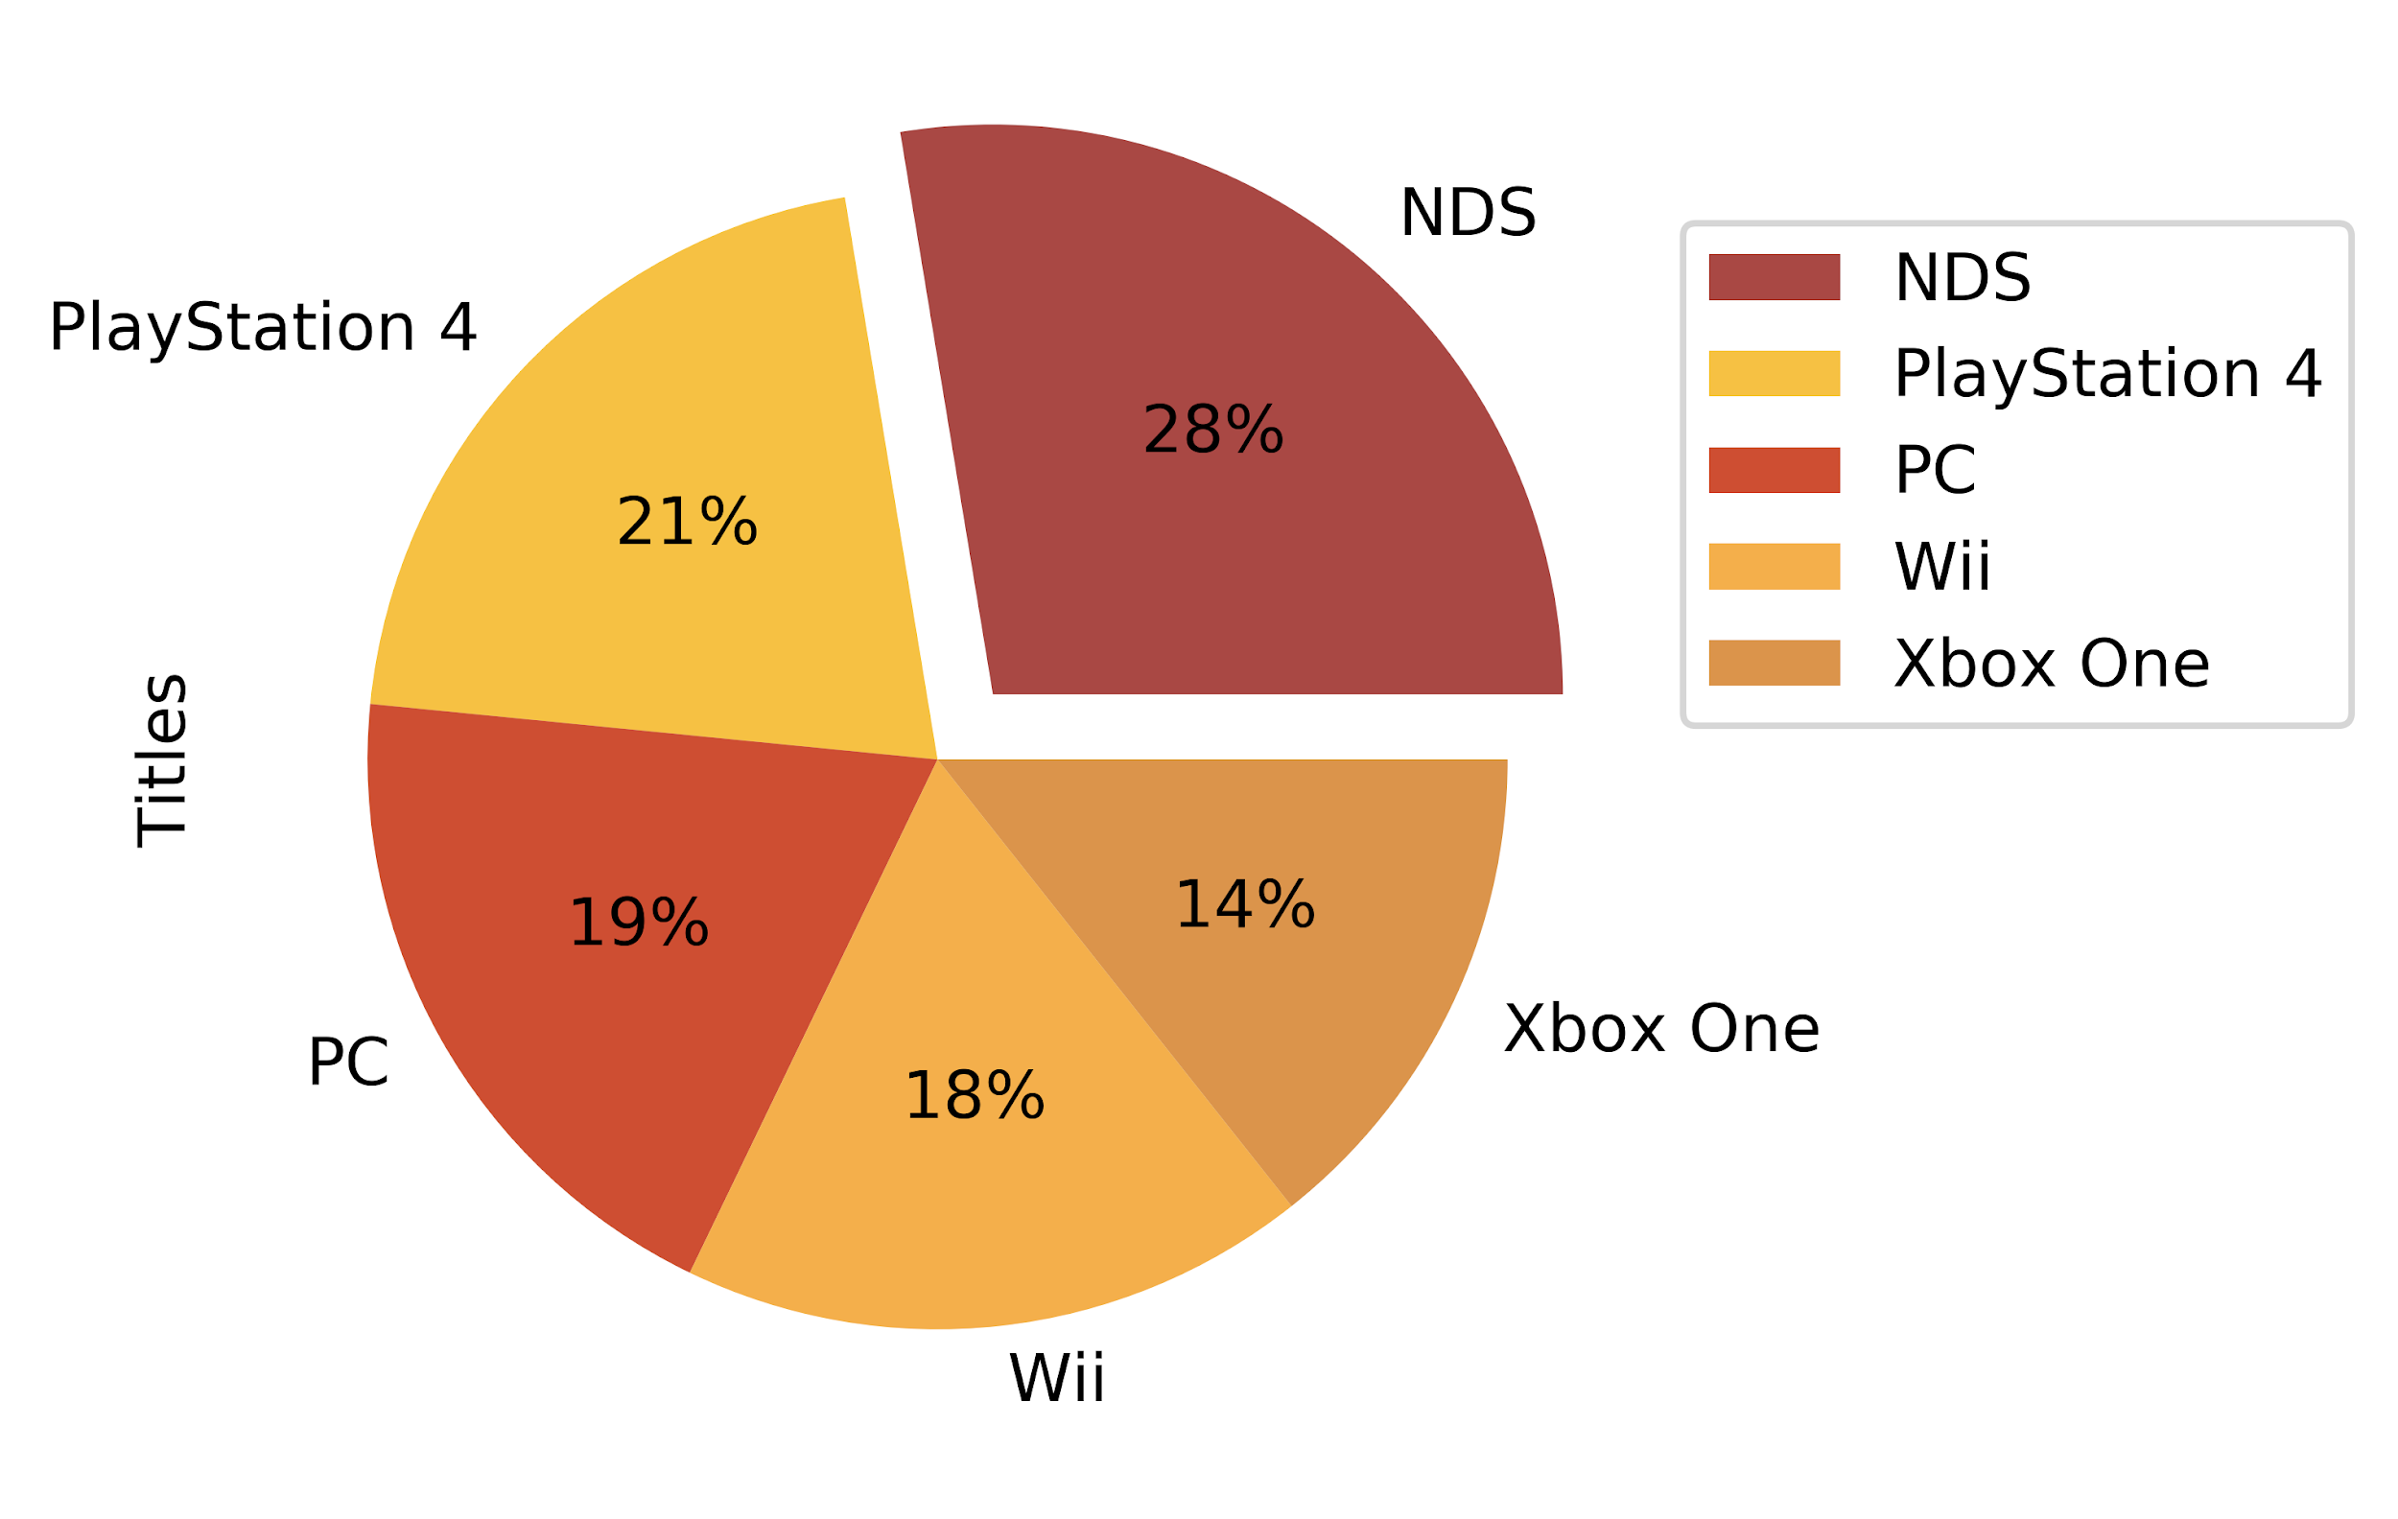
WHAT CONSOLES HAVE THE MOST GAMES?

Slide 12
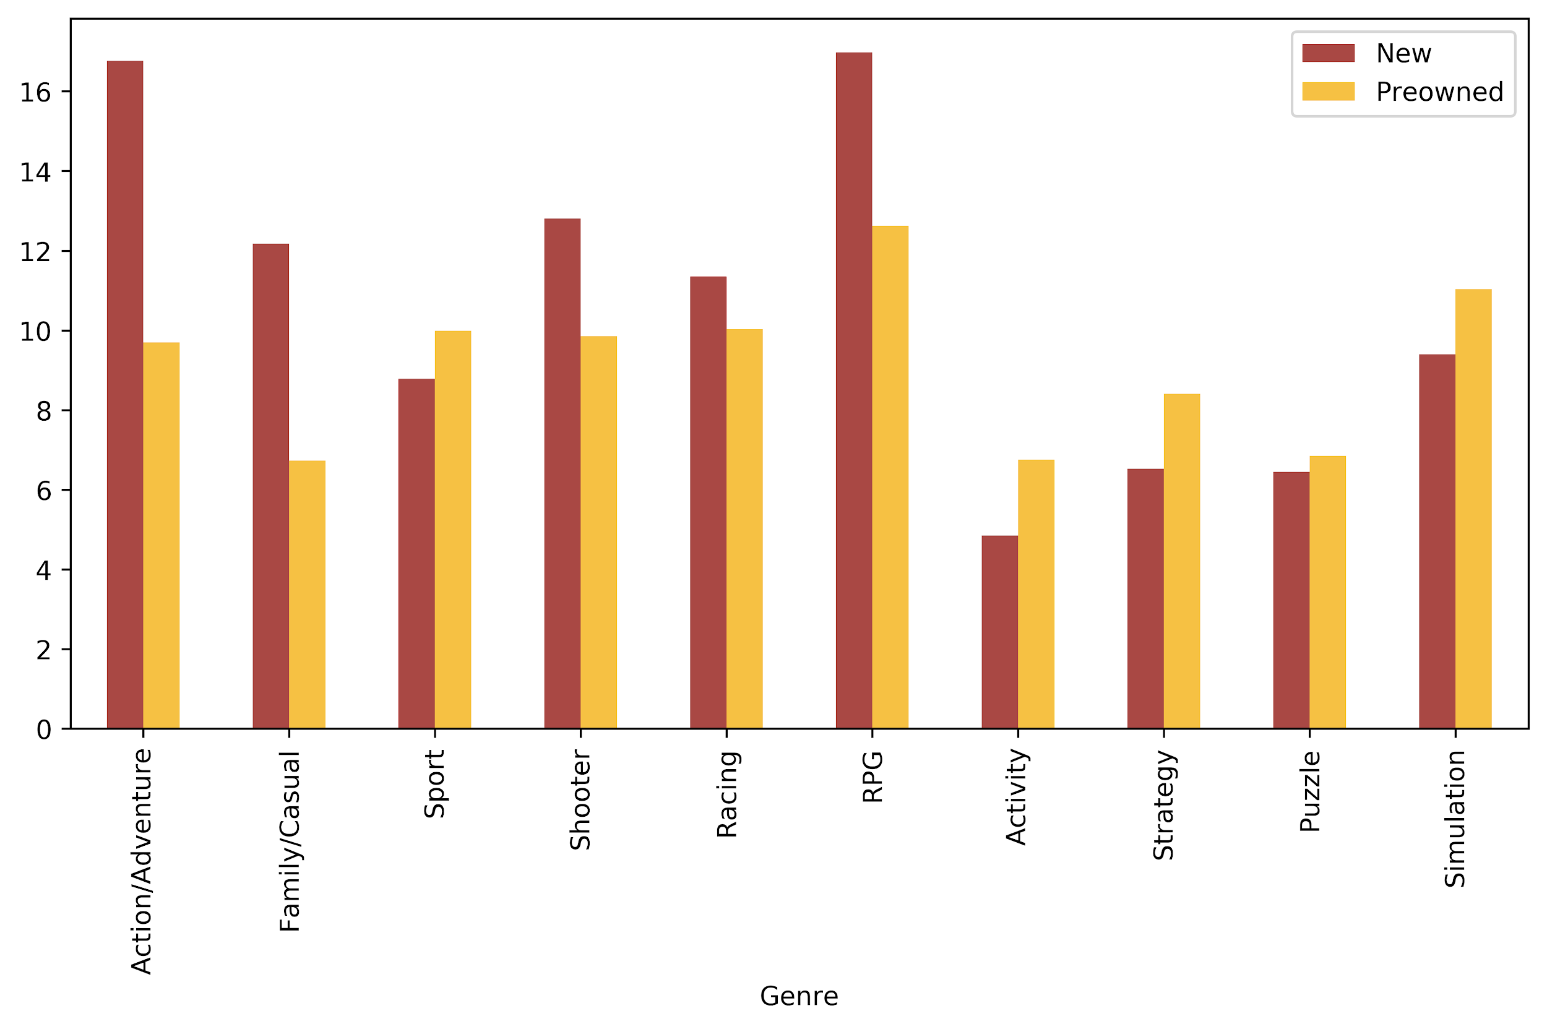
USING THE DATA COLLECTED, WE CAN SEE SALE DIFFERENCE
BETWEEN NEW AND PREOWNED GAMES PER GENRE

Slide 13
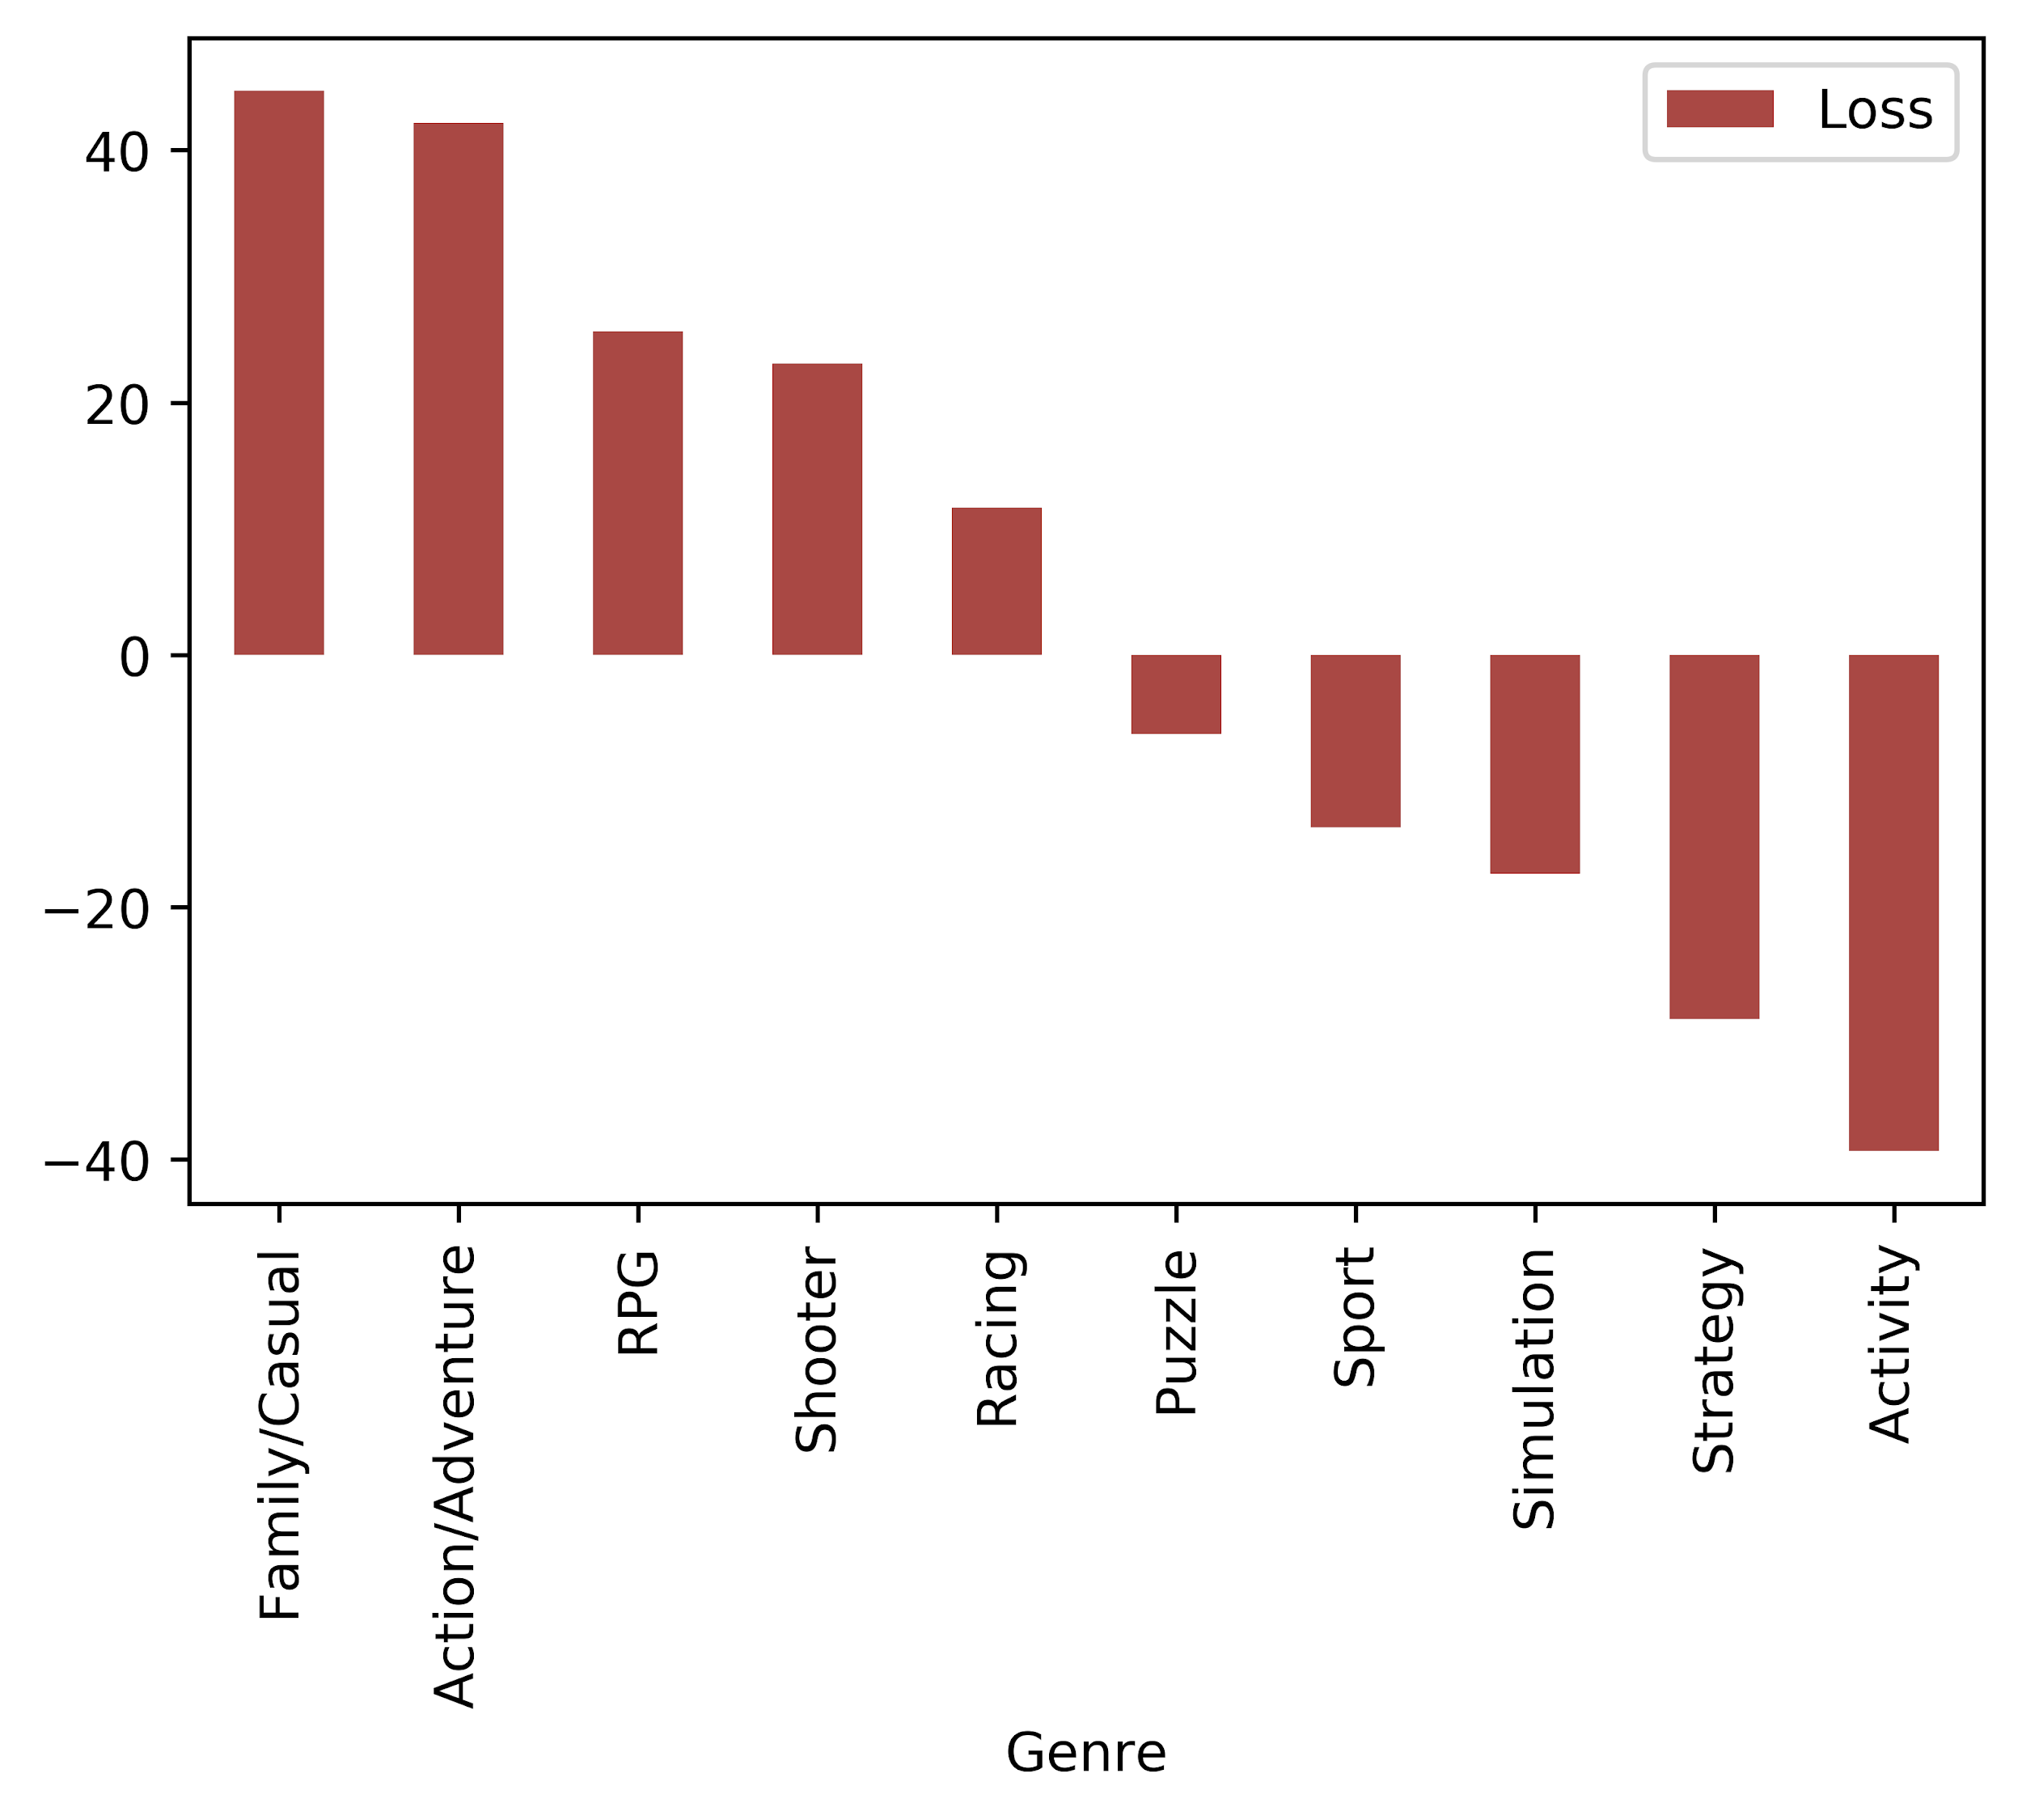
… PERCENTAGE LOSS PER GENRE COMPARED TO NEW SALE

Slide 14
WHERE DO WE GO FROM HERE...
Collect more data from other sources and compile data to increase sample size
To increase profit from acquisition, purchase preowned games from genres that preowned sell more than new
Don’t sell preowned games in largest profit loss genre

Slide 15
THANKS!
Time for the code!

